Slide 1
Liv-Lyf
A Disease Management Web Application

Slide 2

Motivation
To solve the problem people face when they are in search of hospital beds, vaccines, or while visiting some place having concern of number of cases in that area.
Building a project to help Society and ease life of people.
To Empower People to know the actual and live status of Vaccination Centre and Hospitals.
And to promote “Digital India”.

Slide 3
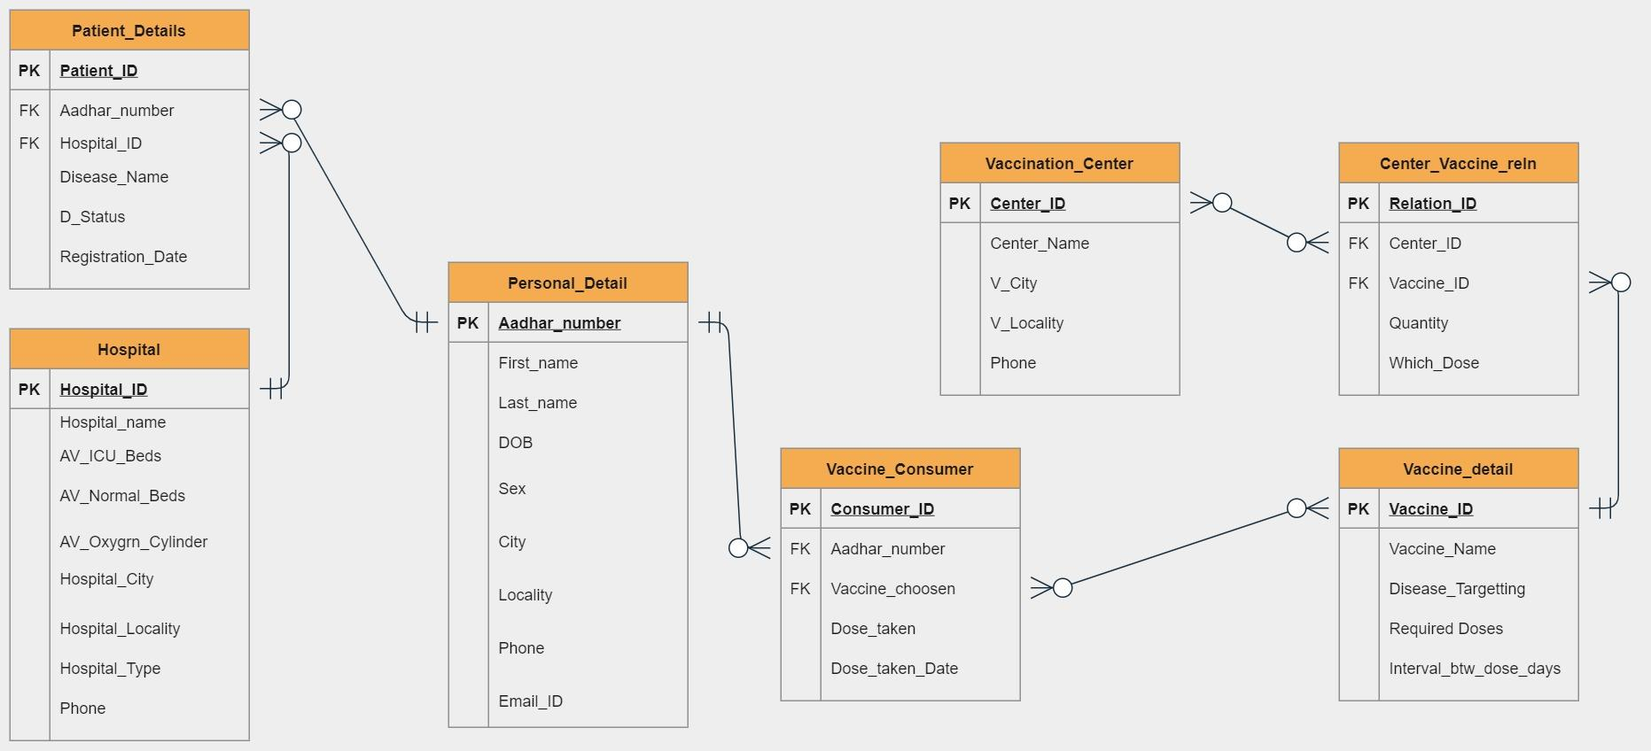
ER Diagram of Liv-Lyf Database
Hospital-Patients
Vaccination-Centers
Vaccination-Center
Hospital-Patient

Slide 4
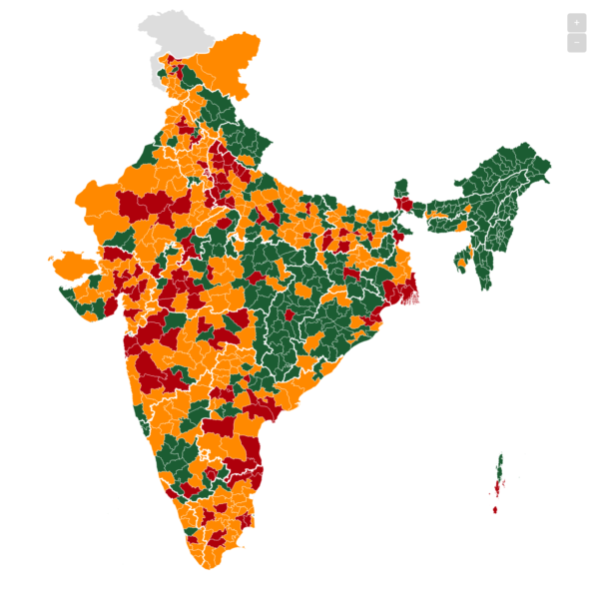
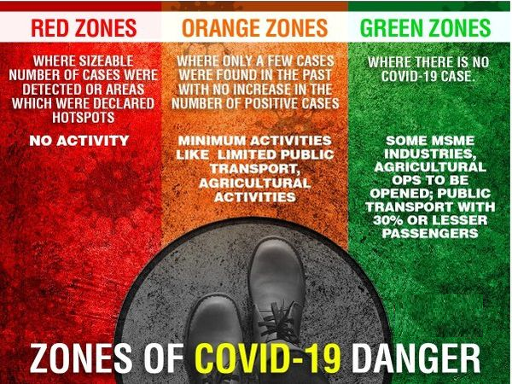

Liv-Lyf Database
Is helpful in finding RED, ORANGE, GREEN Zone- places by looking at COVID Positive Patient from the given region.
Is capable of showing Live-Vaccination Status

Slide 5
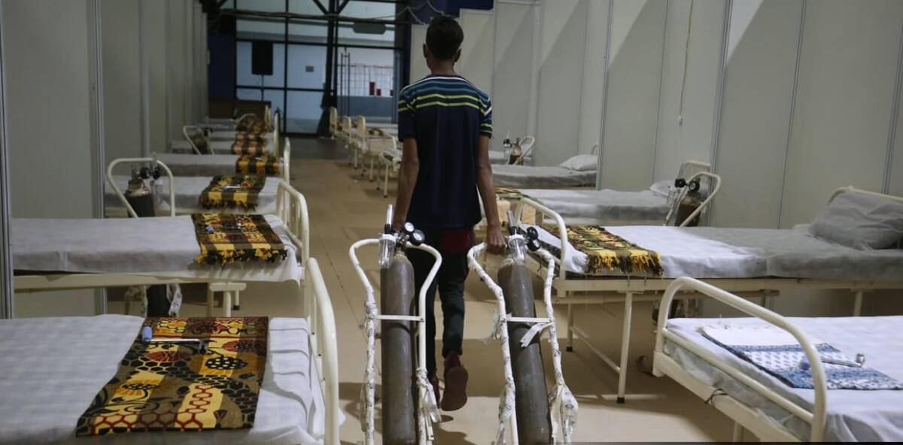

Liv-Lyf Database
Is providing true live-status of available beds and oxygen-cylinder locality-wise/ hospital-wise/city-wise.
Is empowering India by providing honest and transparent status of hospital and vaccination center on the fingertips of every-person

Slide 6
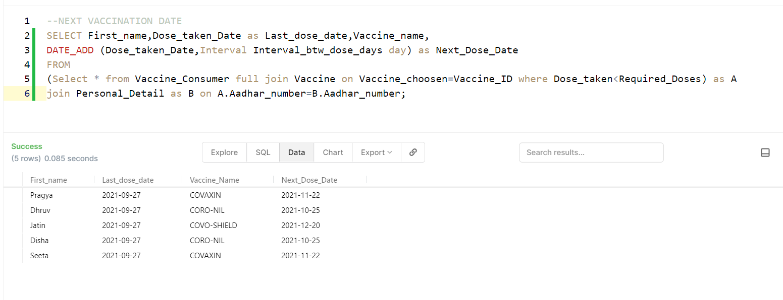
Queries

Slide 7
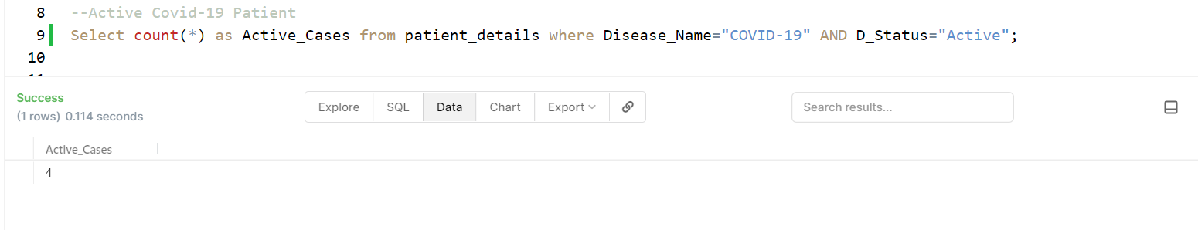
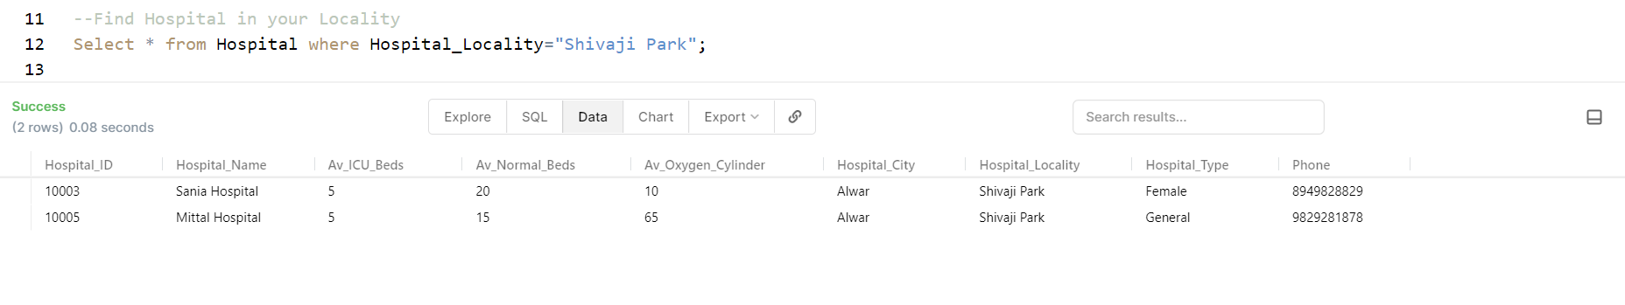
Queries

Slide 8
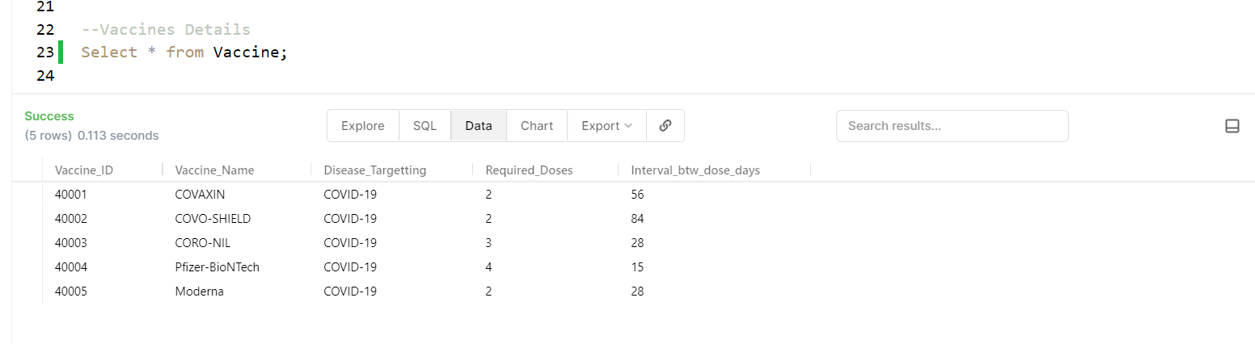
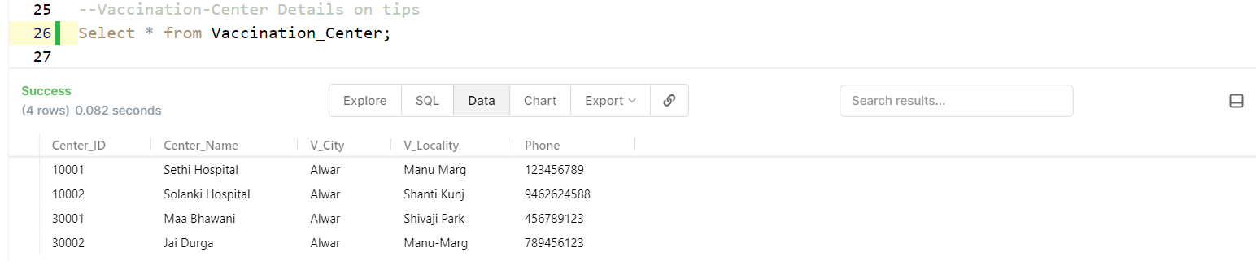
Queries

Slide 9
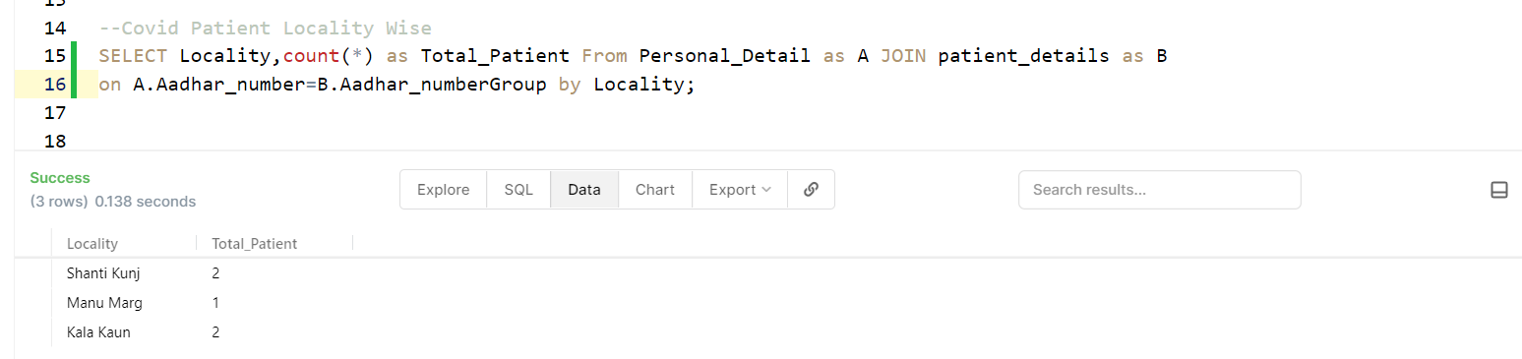
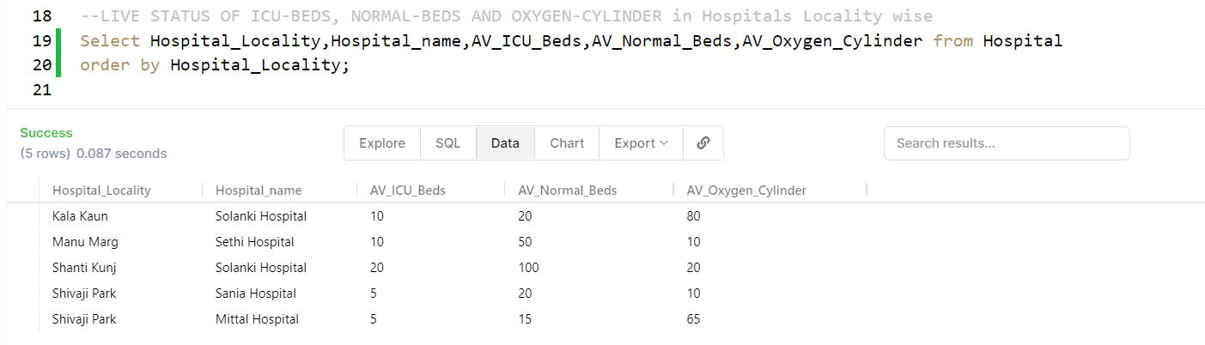
Queries

Slide 10


And Much More to Come...
Feel Free to check our Updates on GitHub.
Liv-Lyf

Slide 11
Thank You
For Your Attention...
Project by-
Aditya Kumar Rai (20075100)
&
Gaurav Kumawat (20075033)

